Slide 1
RANDOM FORESTS
Car Reen, Esteban, Wanying, Yijun

Slide 2
OUTLINE
Introduction
Example 1- Classification
Example 2 - Regression
Conclusion

Slide 3
INTRODUCTION

Slide 4

REGRESSIONS & CLASSIFICATION
Regression: predict a continuous response variable y based on given predictor variables x
Classification: predict a categorical response variable y based on given predictor variables x
What if we have multiple predictor variables?

Slide 5
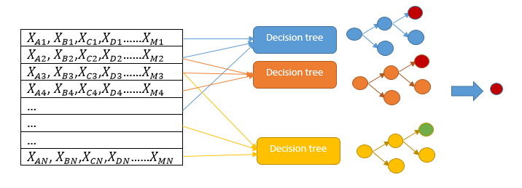
RANDOM FORESTS
It develops lots of decision trees based on random selection of data and random selection of variables.
Classification: Majority vote
Regression: mean of the predicted value

Slide 6
RANDOM FORESTS ALGORITHM
Choose bootstrap sample from the whole data
Grow a tree based on the independent subset of data
- Choose a variable as node each time
- At each node, choose random subset of variables and only consider splitting on these variables
Vote/average the trees to get predictions for new data *Use the number of votes for classification and use the mean of the results for regression.

Slide 7



RANDOM FORESTS ALGORITHM

Slide 8
EXAMPLE 1

Slide 9
CLASSIFICATION EXAMPLE
Come up with an accurate predictive algorithm to estimate annual income bracket of each individual in Mexico
Brackets:
Below $40,000
$40,000 – 150,000
More than $150,000
Variables:
1. Age
2. Gender
3. Highest educational qualification
4. Working in Industry
5. Residence in Metro/Non-metro

Slide 10
CLASSIFICATION EXAMPLE
Prediction for individual:
1. Age: 35 years
2. Gender: Male
3. Highest Educational Qualification: Diploma holder
4. Industry: Manufacturing
5. Residence: Metro

Slide 11
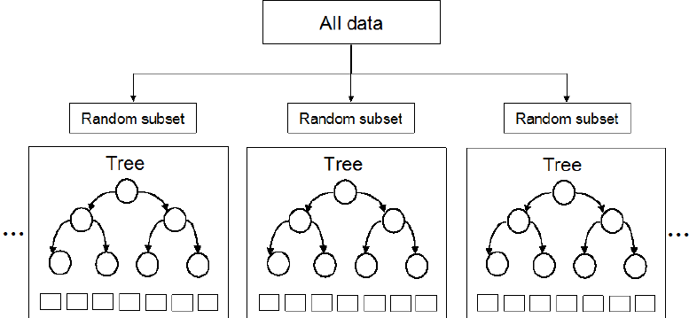
CLASSIFICATION EXAMPLE
Pick up 10k observation with only one variable (for simplicity) to build each tree.
Notes:
In a real life problem, you will have more number of population sample and different combinations of input variables.

Slide 12
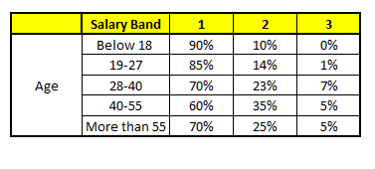


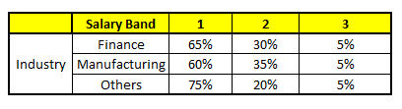
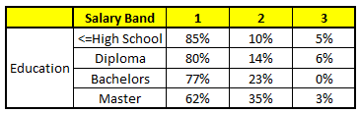
CLASSIFICATION EXAMPLE

Slide 13
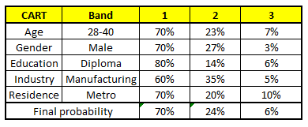
CLASSIFICATION EXAMPLE
Notes:
The final probability is simply the average of the probability in the same salary bands in different CART models. As you can see from this analysis, that there is 70% chance of this individual falling in class 1 (less than $40,000) and around 24% chance of the individual falling in class 2.
The random forests capture the variance of several input variables at the same time and enables high number of observations to participate in the prediction.

Slide 14
EXAMPLE 2

Slide 15

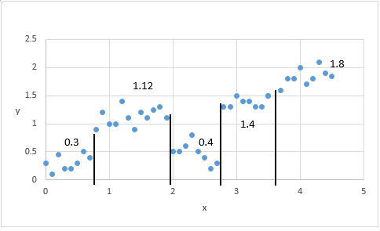
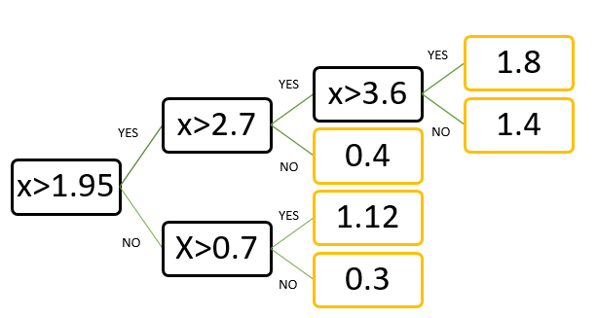
REGRESSION - DECISION TREE
Prediction is numeric/continuous
Choose split that minimizes SSE in each leaf
Notes:
Prediction is more accurate the closer it is to the mean.
minimizer= yhat = average of the y’s

Slide 16
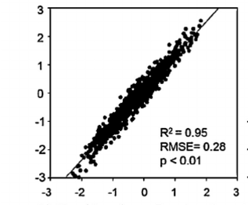
REGRESSION - RANDOM FOREST
Create subsets by sampling with replacement.
Construct decision tree for each subset
Both data subsets and independent variables are randomized
Average the predictions from all individual regression trees
Notes:
In random forest: We create subsets by sampling with replacement. Repeat decision tree construction for each subset and the predictor is the the average of an ensemble of trees. Randomize both data and variables. The overall variance is reduced. Predicting drought conditions in different regions

Slide 17
CONCLUSIONS

Slide 18
Conclusion
Random forest trees can be applied to classification & regression
Random forest trees are very effective tool for prediction
Use training data input to build forest, then generate output for larger set of data

Slide 19
Advantages & Limitations
Advantages:
Accuracy and variable importance generated automatically
Easy to set parameters
Limitations:
Regression cannot predict beyond range in training data
Extreme values cannot be predicted in random forests

Slide 20
Thank you!

Slide 21
Questions?

